Slide 1
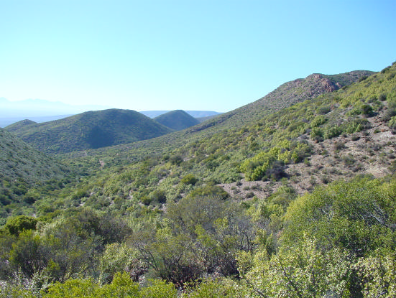
Very High Resolution Remote Sensing of Carbon Stocks in Subtropical Thicket
Dugal Harris (MSc Elec Eng)
Supervisor: Prof A Van Niekerk
Department of Geography & Environmental Studies
Stellenbosch University
Notes:
:20

Slide 2
Aim
The research aim is to develop an automated or semi-automated image analysis technique to accurately estimate P. afra canopy cover and Total Above Ground Carbon (TAGC) in pristine and transformed Subtropical Thicket, over large areas. A secondary aim is for the mapping techniques to make use of freely available, uncalibrated, very high resolution (VHR) aerial imagery from Chief Directorate: National Geospatial Information (NGI).
Notes:
:25
Common name Spekboom

Slide 3
Objectives
Conduct a literature survey.
Perform a field study to establish reference sites with canopy cover ground truth.
Source and rectify aerial imagery from NGI. Develop a technique for radiometric correction of the imagery.
Design a P. afra canopy cover classification algorithm.
Apply the classifier to study area imagery and interpret the results.
Conduct a second field study to locate the Baviaanskloof Nature Reserve (BNR) carbon stock ground truth plots.
Develop a regression technique to determine TAGC from aerial imagery. Evaluate and interpret the carbon stock results.
Notes:
1:05
Separate canopy cover and cs mapping sections
There is existing cs ground truth, I need to locate it accurately in imagery
Common name Spekboom

Slide 4
Research Methods Used To Date
Field study and ground truthing conducted to provide canopy cover training and validation data.
Collaboration with Jan Vlok (a botanist with significant experience in the Little Karoo).
Radiometric image calibration technique developed for calibrating NGI imagery.
Quantitative remote sensing and statistical pattern recognition used to distinguish P. afra from background vegetation.
Notes:
The field study was done in collaboration Jan Vlok, He also has provided general advice, Research is of interest to him as he does some work with Spekboom restoration
The main research method is quantitative remote sensing

Slide 5
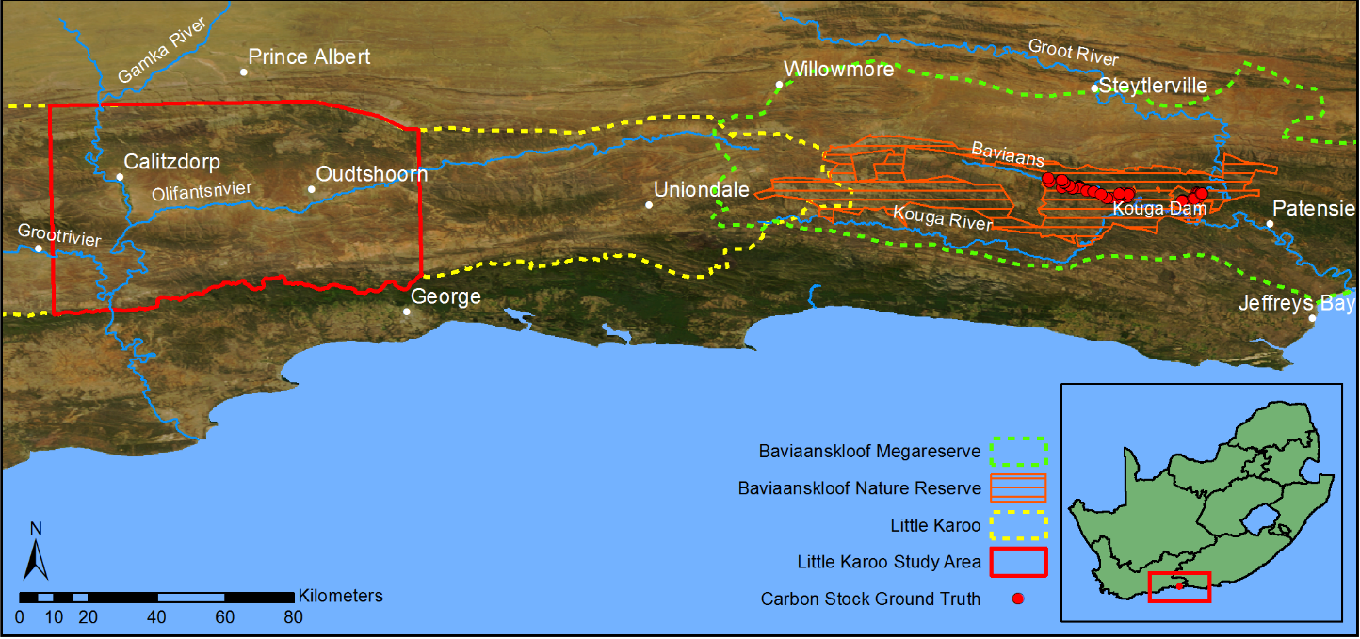
Study Area
Subtropical thicket makes up 35% of the Little Karoo of which roughly 90% is degraded to some extent (Vlok, Cowling & Wolf 2005).
The Baviaanskloof Nature Reserve (BNR) consists of 19 000 ha of Subtropical Thicket of which 95% is degraded (Powell 2009).
Detailed carbon stock ground truth from Powell (2009) will be invaluable.
Little Karoo vegetation map (Vlok, Cowling & Wolf 2005) also very useful.
Notes:
Recently have reduced study area as working with imagery for whole of study area was time consuming – give figures – 1 job of calibrated imagery = 400GB
Not practical to test methods on such a large volume of data
Reduced area still presents challenging calibration/classification problem
MP’s ground truth: 191 5x5m grids covering different habitats and levels of degradation

Slide 6
Radiometric Calibration of VHR Aerial Imagery:
Introduction
VHR aerial imagery holds great potential for quantitative remote sensing but its use is limited by unwanted radiometric variation over temporal and spatial extents.
Accurate geometric calibration techniques are well established (Chandelier & Martinoty 2009) but radiometric calibration is still a challenge (Markelin et al. 2012).
Atmospheric influences, viewing geometry, bidirectional reflectance distribution function (BRDF) effects, sensor variations and terrain effects all contribute to radiometric variations in the imagery.
Radiometric calibration aims to reduce these unwanted variations and obtain measurement of some physical property of the surface, like reflectance.
Radiometric calibration is a requirement for quantitative remote sensing.
Notes:
1:45
Radiometric means spectral content or colour.
Recurring theme in literature around problems, extending methods over space and time which is partially calibration issue.
Effects that result in radiometric variation are phsyically complex and difficult to simulate and quantify.
Absolute meas not strictly necessary, so long as consistent can be relative but absolute useful for combining / comparing data, consistency over time.
Also req’d for my research, ngi economical but uncalibrated. Allows fusion w
The high spatial resolution of these images enables analyses on a finer spatial scale than most satellite based platforms can provide and consequently opens up the exploitation of information such as texture, object-based features and unmixed pixel spectra that is not available or less effective in lower resolution images

Slide 7
Background:
BRDF and Atmospheric Correction
BRDF effects are commonly corrected for using a kernel-based approach (Roujean, Leroy & Deschamps 1992).
Radiometric transfer modelling (RTM), such as ATCOR (Richter & Schläpfer 2002), MODTRAN (Berk et al. 1999) and 6S (Vermote et al. 1997), are used for atmospheric correction.
While these methods are successful on single images, mosaics consisting of many aerial images present new challenges:
Large view angles (Lelong et al. 2008).
Multi-day campaigns (Collings et al. 2011; Chandelier & Martinoty 2009; Honkavaara et al. 2009).
Each land cover has its own unique BRDF (Honkavaara et al. 2009; Strahler et al. 1999).
Complexity and computation time.
Availability of atmospheric measurements.
Notes:
1:21
BRDF and atmospheric effects are main causes of radiometric inconsistency
The popular technique of kernel-based BRDF correction models different scattering modes of the land cover as parameterised kernels and the BRDF as a linear combination of these kernels
RTM models complex process of how sunlight is scattered in the atmosphere and off the land surface based on physical principles.
Large view angles of aerial imaging cameras cause the solar and viewing geometries to vary significantly throughout the image i.e. BRDF (Lelong et al. 2008).
Long history of atcor and brdf but…. Aerial is challenge
Multi-day campaigns. are usually carried out over multiple days resulting in significant variation in BRDF and atmospheric conditions (Collings et al. 2011; Chandelier & Martinoty 2009; Honkavaara et al. 2009).
Each land cover has its own unique BRDF (Honkavaara et al. 2009; Strahler et al. 1999) and corrections should ideally model each of these covers separately (Collings et al. 2010; Honkavaara et al. 2009).

Slide 8
Background:
Calibration of Aerial Image Mosaics
A number of methods targeting aerial imagery have been recently developed (López et al. 2011; Collings et al. 2011; Gehrke 2010; Chandelier & Martinoty 2009).
All based on matching overlapping areas of adjacent images and use simplified models of atmospheric and BRDF effects.
Computationally time consuming and complex to implement.
Known ground references are needed to achieve transformation to absolute surface reflectance.
Notes:
:50
Also req’d for my research, ngi economical but uncalibrated.
The high spatial resolution of these images enables analyses on a finer spatial scale than most satellite based platforms can provide and consequently opens up the exploitation of information such as texture, object-based features and unmixed pixel spectra that is not available or less effective in lower resolution images
The parameters of the model are solved by minimising a cost function that includes costs for internal accuracy of each image, similarity of overlapping image regions and smoothness of the mosaic.
Known ground ref often not practical eg costly or old imagery

Slide 9
Background:
Cross Calibration
Cross calibration is a technique of calibrating a satellite sensor using the measurements of a well-calibrated reference sensor. The need for ground measurements is avoided.
A linear calibration model is fitted between actual uncalibrated and simulated reference sensor measurements.
A number of investigations have reported success with this approach (Gao et al. 2013; Kamei et al. 2012; Li, Yang & Wang 2012; Jiang & Li 2009).
Reference satellite image should be concurrent, collocated and spectrally similar to the uncalibrated image. Desert regions are favoured (Liu et al. 2004).
Notes:
:50
Cross calibration was suggested by avn as a possible way around some of the difficulties discussed.
Importantly it avoids the need to ground measurements
If viewing and solar geometries differ substantially between the reference satellite and uncalibrated sensor, knowledge of the BRDF of the land cover is necessary to convert for solar and viewing geometry. Terrain?
In some cases a RTM and BRDF model is used to simulate the reference TOA radiance for the viewing conditions of the uncalibrated sensor.
Success sometimes with accuracies as good as ground ref / vicarious calib approach.
Desert regions with flat terrain, clean and dry atmosphere and where the surface reflectance varies little over space and time are favoured (Liu et al. 2004).

Slide 10
Method:
Rationale
Traditional BRDF and atmospheric correction of mosaics of many aerial images is impractical and does not address the need for mosaic smoothness/continuity.
New mosaic calibration techniques are complex, not well-established and require ground reflectance measurements.
Cross calibration methods produce sensor-to-sensor calibrations and still require atmospheric and BRDF correction to produce surface reflectance per image.
We propose a simplified procedure where cross calibration is performed per image to a concurrent surface reflectance satellite image:
No need for additional BRDF and atmospheric correction step.
No ground reflectance measurements.
Notes:
1:20
Smoothness = seamlines
Cross calibration methods produce sensor-to-sensor calibrations based on linear models and consequently require atmospheric and BRDF correction to produce surface reflectance. i.e. sensor calibration is infrequent but brdf atcor is per image.
Cross calibration has potential but…
Image-to-image instead of a sensor-to-sensor correction.
Based on this we developed our own method

Slide 11
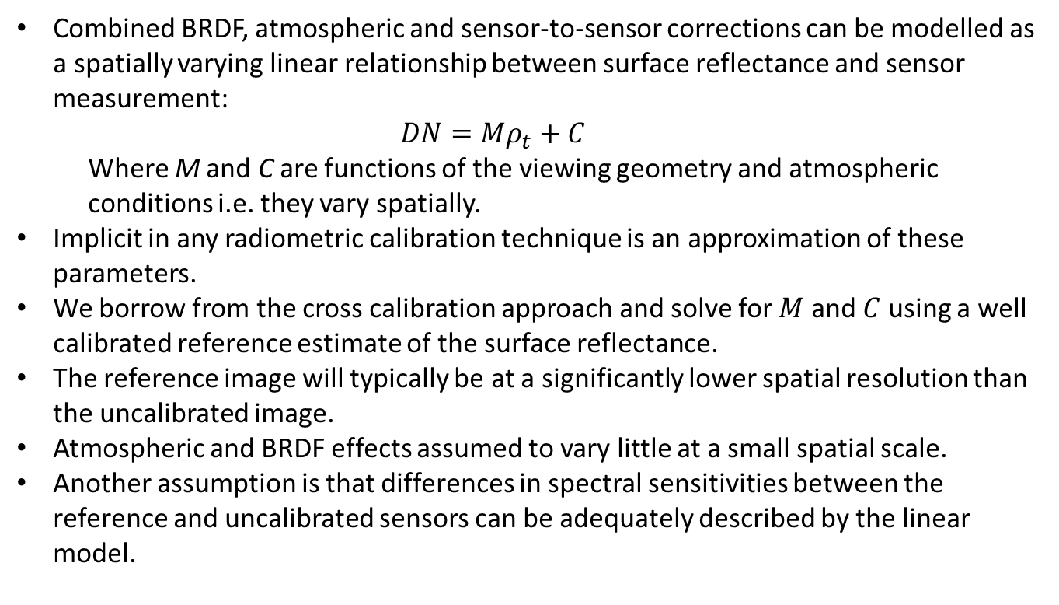
Method:
Formulation
Combined BRDF, atmospheric and sensor-to-sensor corrections can be modelled as a spatially varying linear relationship between surface reflectance and sensor measurement:
$$DN=Mρ_{t}+C$$
Where M and C are functions of the viewing geometry and atmospheric conditions i.e. they vary spatially.
Implicit in any radiometric calibration technique is an approximation of these parameters.
We borrow from the cross calibration approach and solve for $M$ and $C$ using a well calibrated reference estimate of the surface reflectance.
The reference image will typically be at a significantly lower spatial resolution than the uncalibrated image.
Atmospheric and BRDF effects assumed to vary little at a small spatial scale.
Another assumption is that differences in spectral sensitivities between the reference and uncalibrated sensors can be adequately described by the linear model.
Notes:
1:50
M and C are parameters of linear model
Where $M={\frac{1}{π}c}_{0}τ_{↑}τ_{↓}τ_{g}E_{s}cosθ$ and $C={c_{1}+\frac{1}{π}c}_{0}ρ_{a}E_{s}cosθ$are functions of the
M and C are not single vals per image but surfaces / rasters
Use of a spatially varying linear relation to model radiative transfer is also advocated in Collings et al. (2011) and Gehrke (2010).
The reference surface reflectance image should have been captured at a similar time to the uncalibrated image or set of images to avoid phenological differences between the reference and uncalibrated images.
Calibrated surface reflectance products, such as those produced from MODIS and MISR data, typically have resolutions of the order of 500m while aerial images usually have resolutions of 2m or higher.
Assumed and that the reference resolution is sufficient to capture gradual variations in atmospheric conditions and BRDF.
This assumption is supported by the results of the case study which is discussed later in the paper.

Slide 12
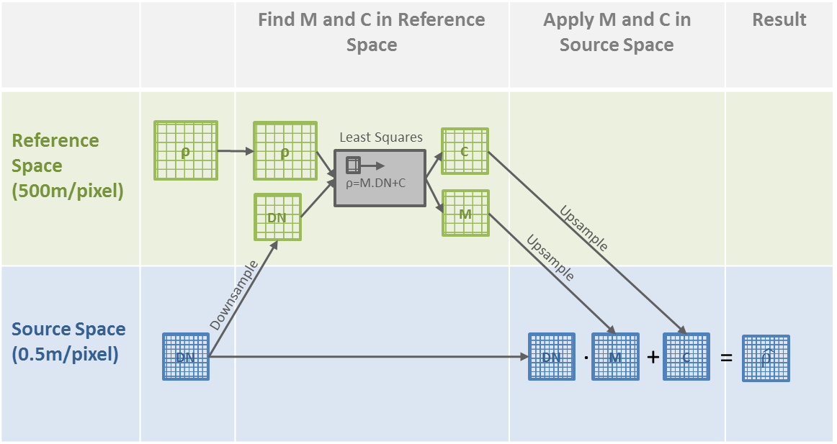
Method:
Procedure
Notes:
1:40
Least squares estimates of $M$ and $C$ are found for each pixel of the reference image inside a sliding window, as described by Equation
Aspects of resampling, cropping images etc I’m leaving out

Slide 13
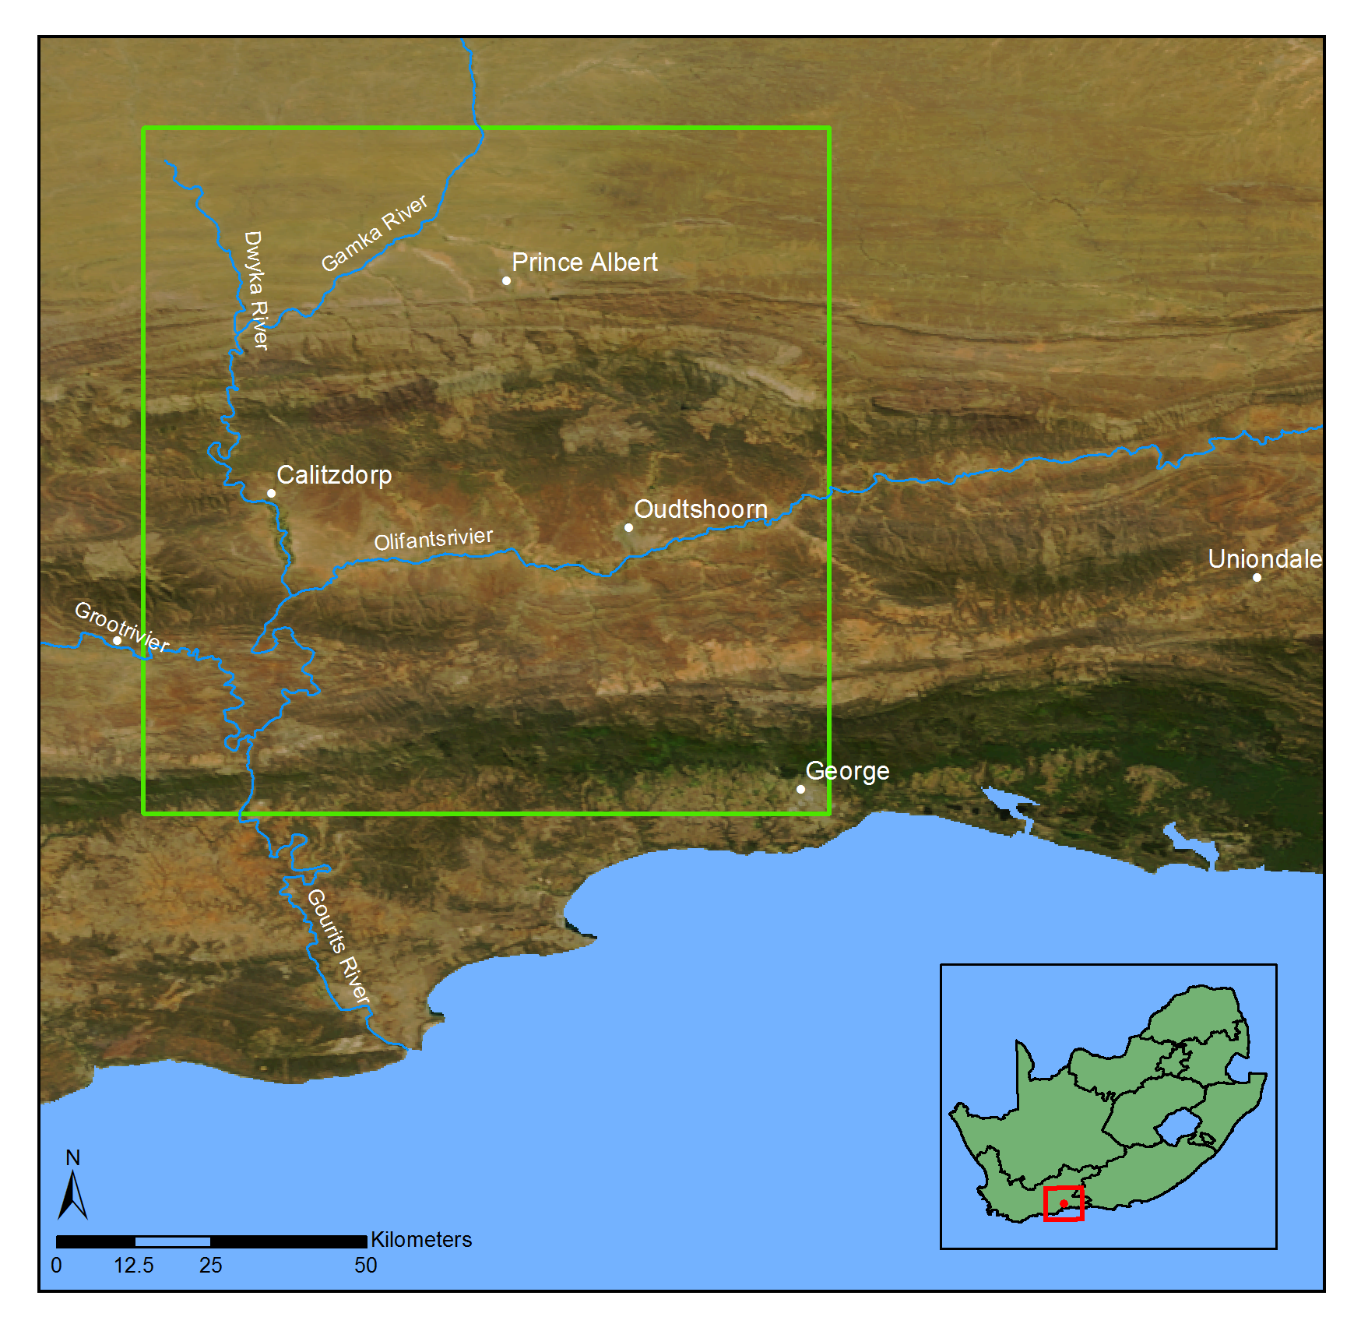
Application:
Study Site and Data
NGI 0.5m/pixel multi-spectral aerial imagery. 2228 images captured during four separate aerial campaigns flown over multiple days from 22 January 2010 to 8 February 2010.
MODIS MCD43A4 16-day composite image for the period from 25 January 2010 to 9 February 2010 selected as a reference for the cross calibration. 500m/pixel with similar bands to NGI.
Notes:
:50
NGI 4 band, NIR
This image has a 500m resolution and contains nadir BRDF-adjusted reflectance (NBAR) data composited from the best values over a 16 day period.

Slide 14
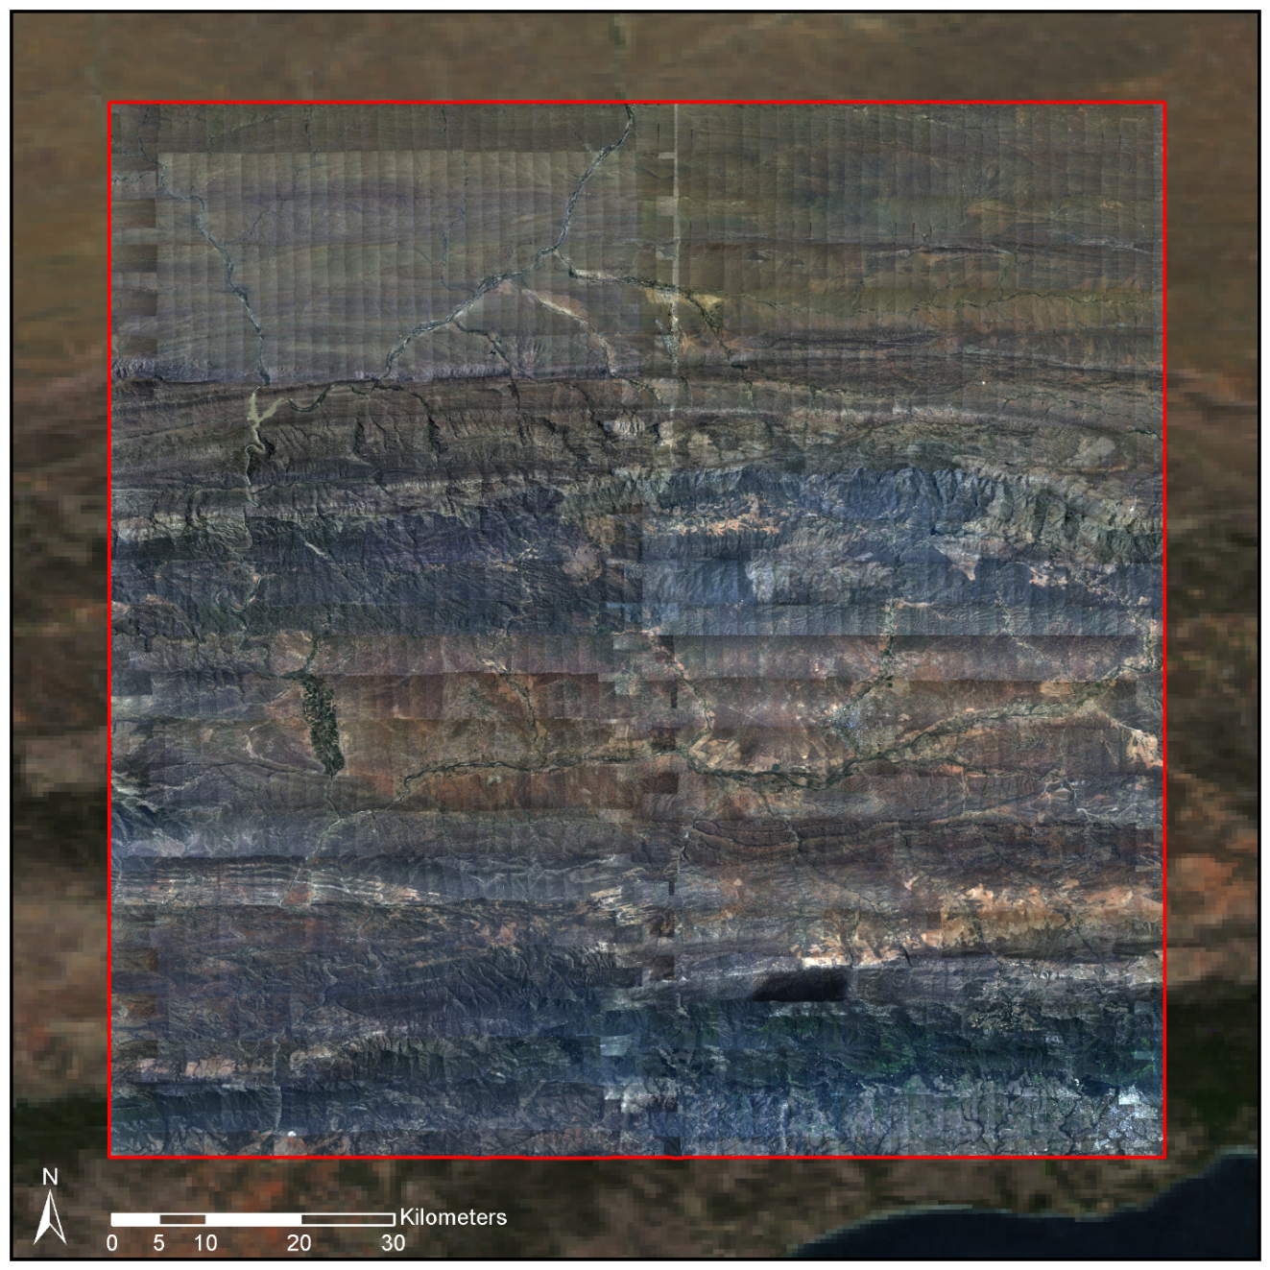
Results:
Uncalibrated NGI Mosaic
Notes:
:30
Visual ind of eff
Seamlines & gradients due to brdf, atmospheric effects

Slide 15
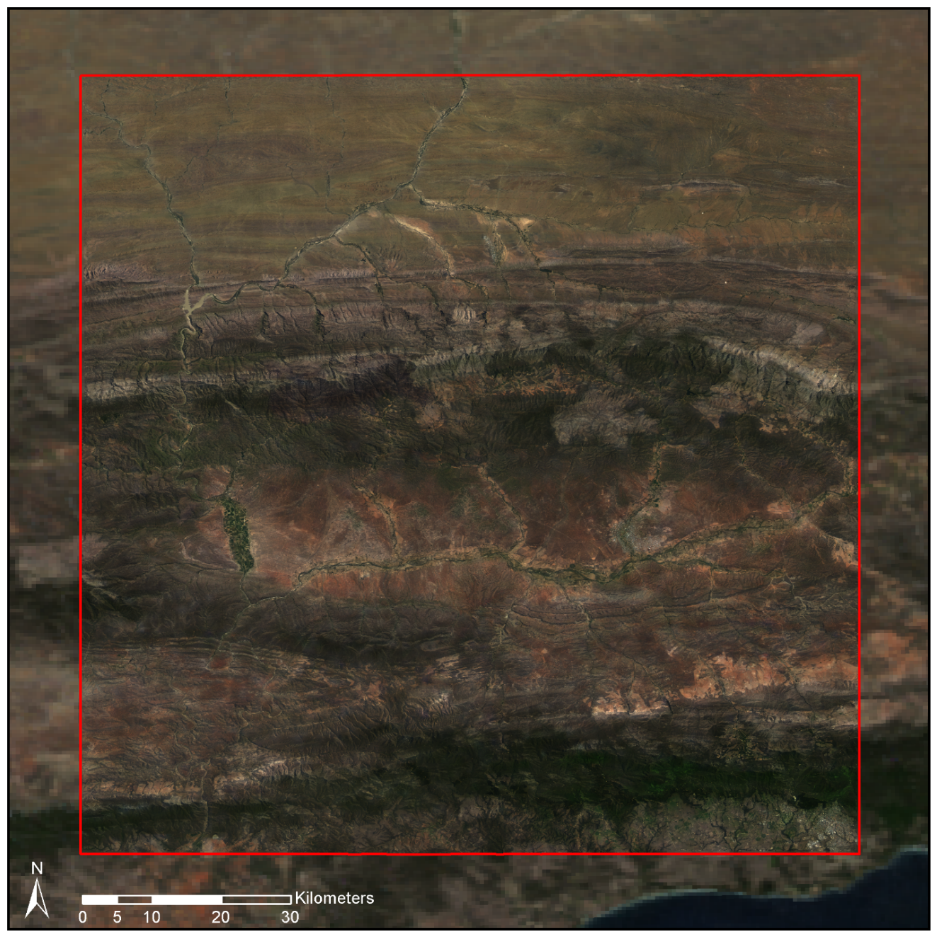
Results:
Calibrated NGI Mosaic
Notes:
:15
Seamlines removed / matches bg modis

Slide 16
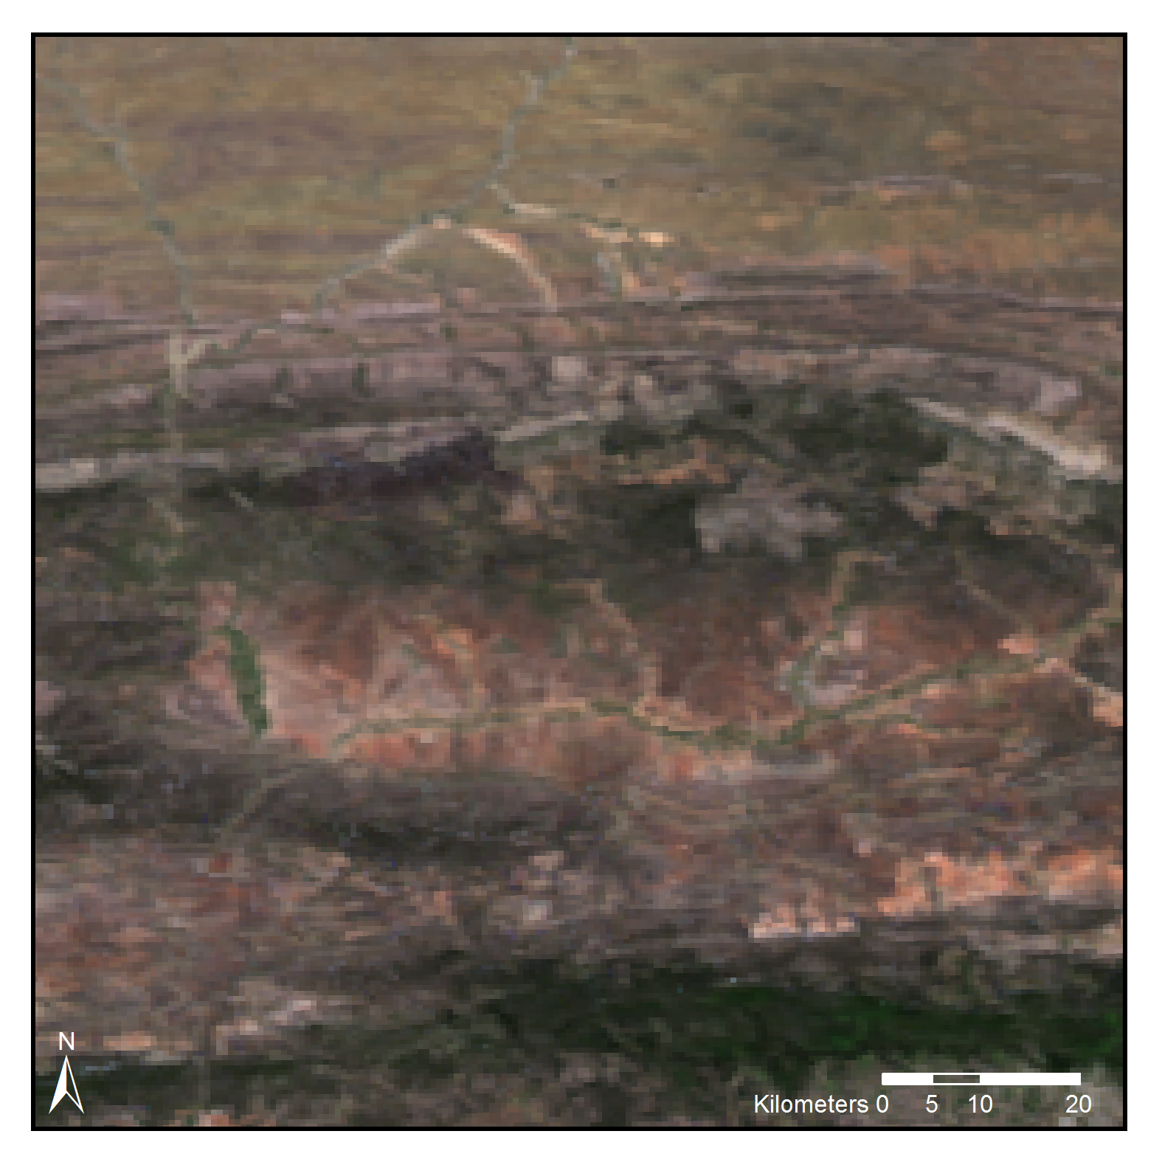
Results:
Comparison of NGI 500m Mosaic to MODIS Reference
MODIS Reference
Notes:
:45
Comparison to ref at ref resolution
Resampling alg used is cubic spline which has constraints of smoothness which is desirable in that brdf / atmopsheric effects vary slowly smoothly. But this means we don’t expect exact match as this would be overfitting to noise in ref but we nevertheless expect a decent match
This comparison serves as a rough check on the principal of the method and of the assumuption that there some consistent rel inside the sliding window that we are modelling (i.e. perhaps that brdf and at effects are adequately repr by modis spatial res)
We can make some sense of differences as rough check on the validity of principal

Slide 17
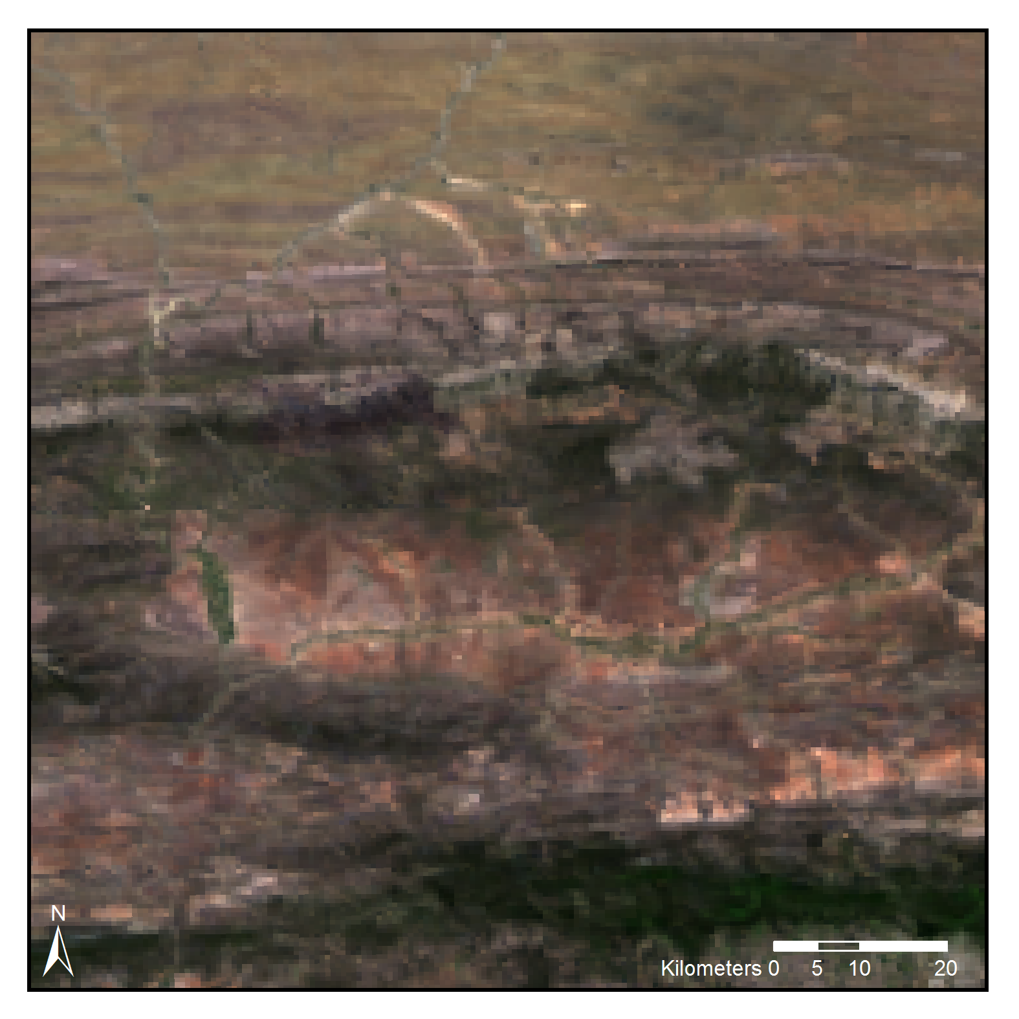
Results:
Comparison of NGI 500m Mosaic to MODIS Reference
NGI Mosaic
Notes:
Reasonable match
Differences arise due to shadows, small high refl areas which are areas where the slowly varying brdf assumption does not hold

Slide 18
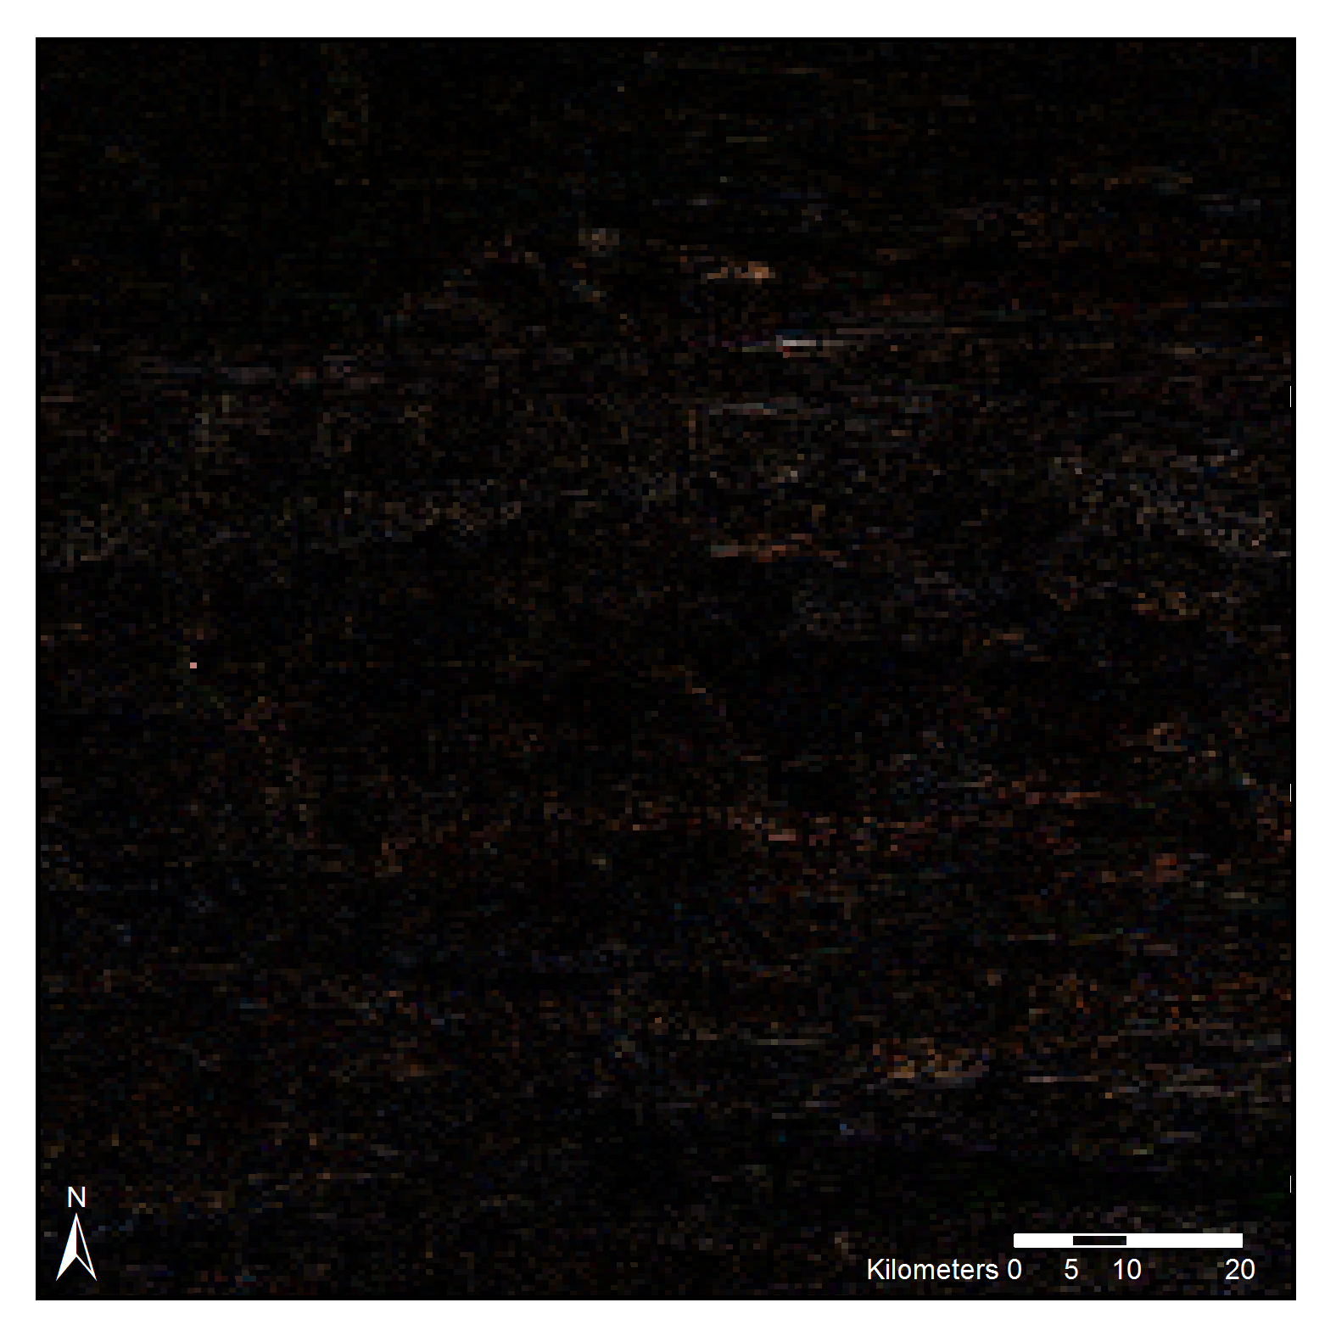
Results:
Comparison of NGI 500m Mosaic to MODIS Reference
Difference Raster
(2|NGI-MODIS|)
Notes:
Errors occur where shadows in NGI images (viewing angle)
Also occur bright sandy spots where BRDF assumption doesn’t hold.

Slide 19
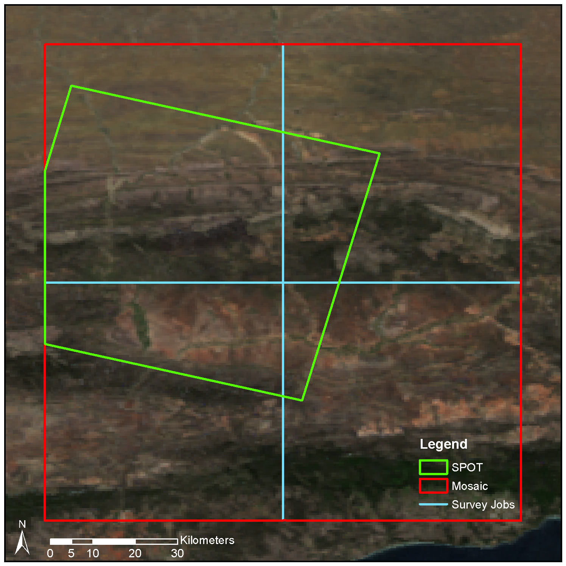
Results:
Comparison to SPOT
10m resolution SPOT 5 level 1A image, acquired on 21 January 2010.
Orthorectified and corrected to surface reflectance using ATCOR 3.
SPOT resolution of 10m useful for checking assumption of slowly varying BRDF and atmospheric effects.
Notes:
:45
One shouldn’t be surprised if things fit well to your ref so we wanted to compare to a independent ref and one closer to res of NGI.
SPOT as independent

Slide 20
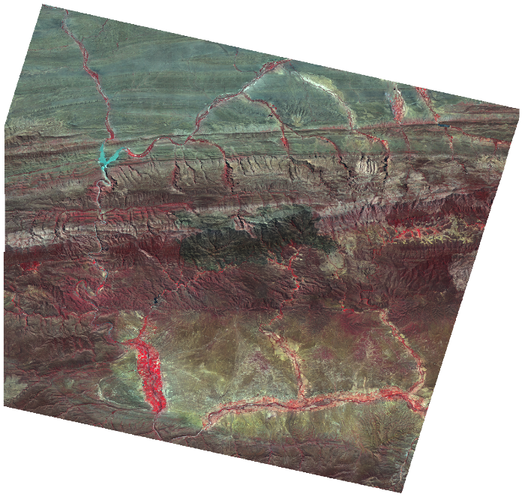
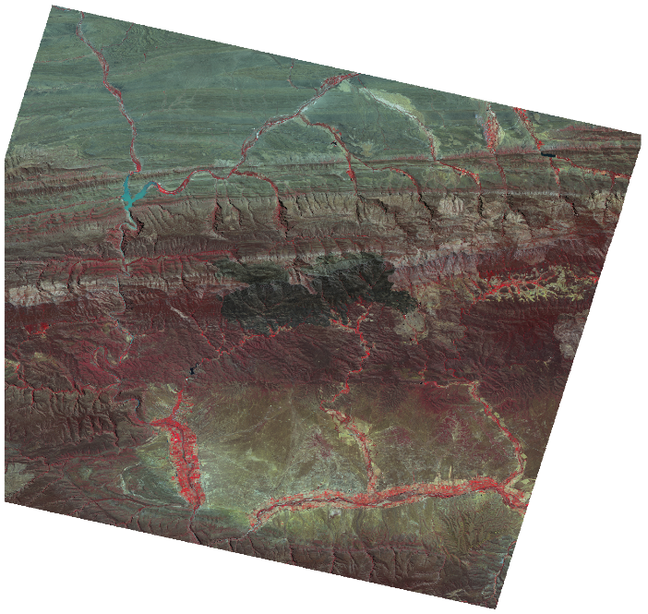
Results:
Comparison to SPOT
Mean absolute difference of 3.92%
NGI Calibrated Mosaic
SPOT Surface Reflectance
Notes:
:40
Comparison, colour-infrared NGI mosaic to concurrent SPOT surface refl. Very similar. Considering simplicity of method is very good result, better than other est methods.
While SPOT is known to have its own calibration challenges, the similarity of these is strong indication that something is working well.
Quantitative rs on eerial imagery of large scales still fairly uncommon mainly due to calibration issues, methods struggle to generalise over spatial/temporal, recurring theme in rs
Hope this will help open up NGI imagery to other rs, as it is valuable source of info that has been underutilised

Slide 21
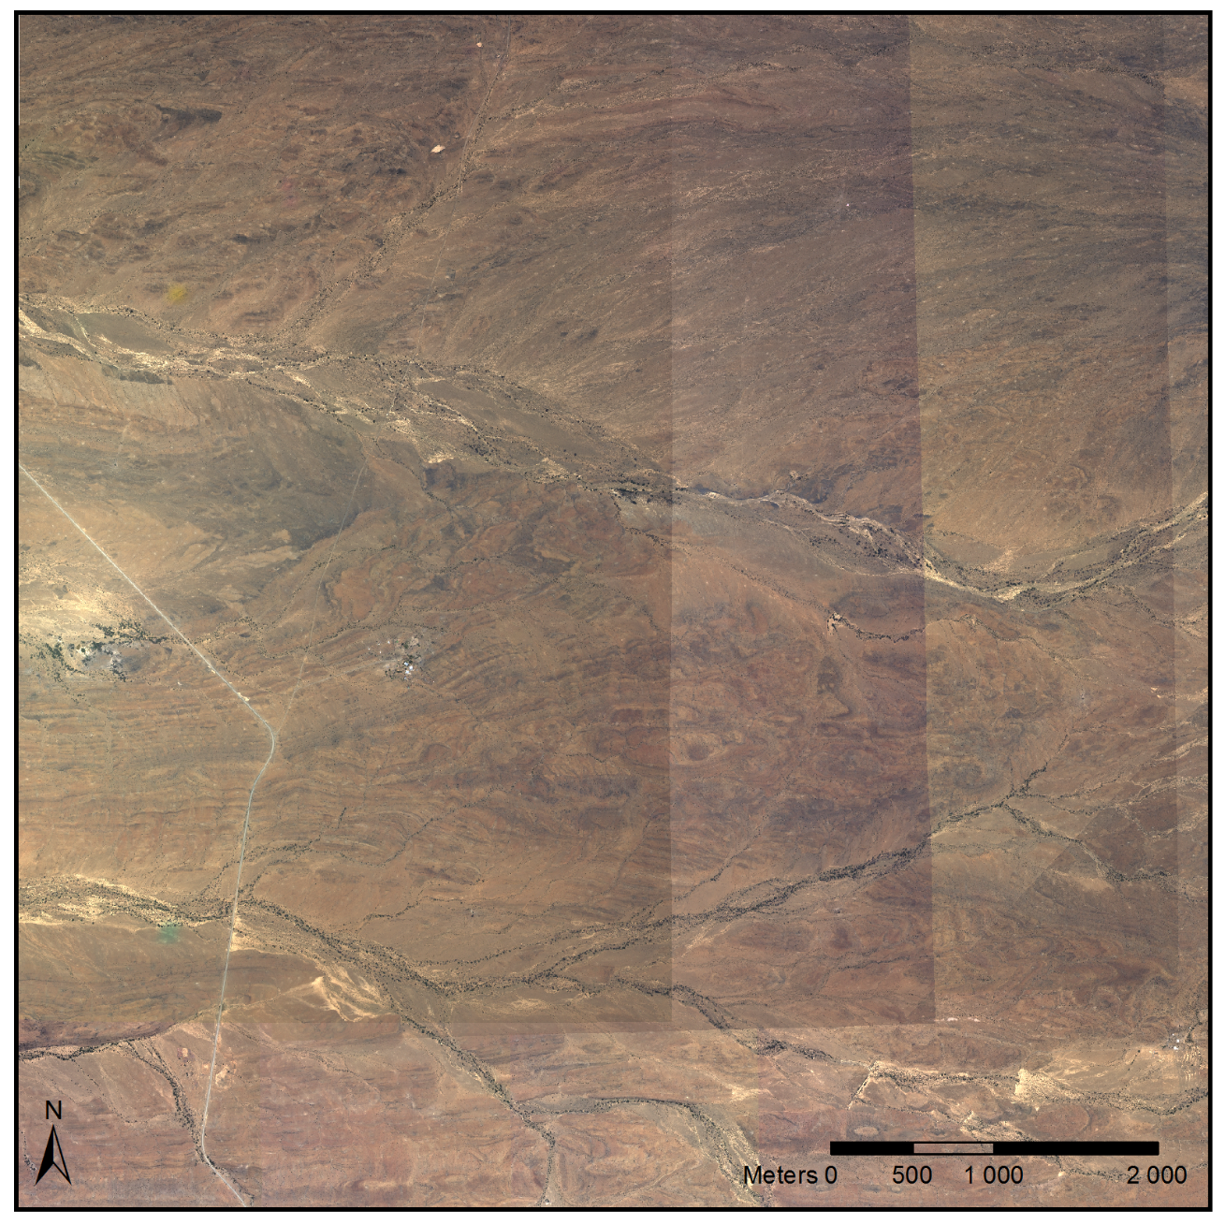
Results:
Hot-spots and Seam Lines
NGI Uncalibrated Close-Up
Notes:
Bright spot is hot spot, refl of sun that happens in certain terrains. Not real and eg of BRDF.

Slide 22
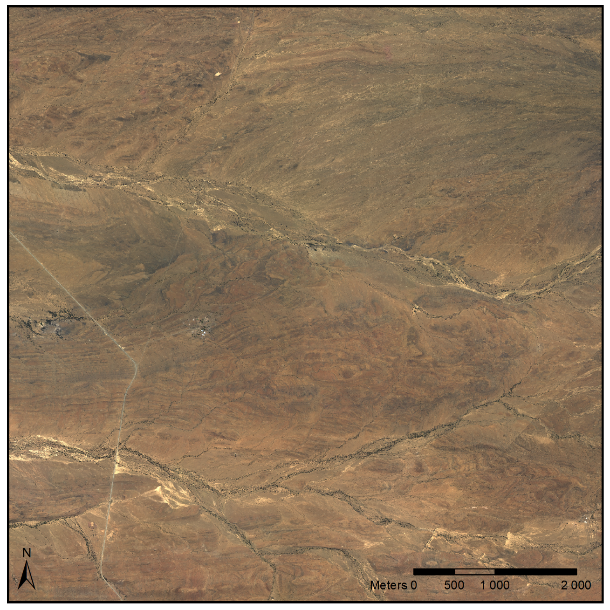
Results:
Hot-spots and Seam Lines
NGI Calibrated Close-Up
Notes:
:45

Slide 23
Discussion
No need for explicit BRDF or atmospheric correction.
Mosaic smoothness achieved implicitly.
Relatively simple and fast.
Need for ground reflectance measurements avoided.
Requires spectrally similar and concurrent reference image.
Assumptions of slowly varying BRDF and similarity of uncalibrated and reference sensor spectral sensitivities may not always hold in practice and are limitations of the method.
Notes:
1:50
M and C are parameters of linear model
Where $M={\frac{1}{π}c}_{0}τ_{↑}τ_{↓}τ_{g}E_{s}cosθ$ and $C={c_{1}+\frac{1}{π}c}_{0}ρ_{a}E_{s}cosθ$are functions of the
M and C are not single vals per image but surfaces / rasters
Use of a spatially varying linear relation to model radiative transfer is also advocated in Collings et al. (2011) and Gehrke (2010).
The reference surface reflectance image should have been captured at a similar time to the uncalibrated image or set of images to avoid phenological differences between the reference and uncalibrated images.
Calibrated surface reflectance products, such as those produced from MODIS and MISR data, typically have resolutions of the order of 500m while aerial images usually have resolutions of 2m or higher.
Assumed and that the reference resolution is sufficient to capture gradual variations in atmospheric conditions and BRDF.
This assumption is supported by the results of the case study which is discussed later in the paper.

Slide 24
Time Schedule
No. | Task Description | Deliverable | Jun-15 | Aug-15 | Oct-15 |  | Dec-15 | Feb-16 | Apr-16 | Jun-16 | Aug-16 | Oct-16 | Dec-16
1 | Editing papers
2 | Field study
3 | Carbon-stock mapping
4 | Dissertation write-up
Notes:
:20

Slide 25
References
Berk A, Anderson GP, Bernstein LS, Acharya PK, Dothe H, Matthew MW, Adler-Golden SM, Chetwynd JH, Richtsmeier SC, Pukall B, Allred CL, Jeong LS & Hoke ML 1999. MODTRAN4 radiative transfer modeling for atmospheric correction. In Proceedings of SPIE - The International Society for Optical Engineering, 348–353. Denver, CO: Society of Photo-Optical Instrumentation Engineers.
Chandelier L, & Martinoty G 2009. A radiometric aerial triangulation for the equalization of digital aerial images and orthoimages. Photogrammetric Engineering & Remote Sensing 75(2), 193–200.
Collings S, Caccetta P, Campbell N & Wu X 2011. Empirical models for radiometric calibration of digital aerial frame mosaics. IEEE Transactions on Geoscience and Remote Sensing 49(7), 2573–2588.
Gao C, Jiang X, Li X & Li X 2013. The cross-calibration of CBERS-02B/CCD visible-near infrared channels with Terra/MODIS channels. International Journal of Remote Sensing 34 (9-10): 3688–3698.
Gehrke S 2010. Radiometric processing of ADS imagery: mosaicking of large image blocks. In Opportunities for Emerging Geospatial Technologies, 184–195. American Society for Photogrammetry and Remote Sensing Annual Conference 2010 held 26-30 April 2010. San Diego, United States: American Society for Photogrammetry and Remote Sensing.
Honkavaara, E, Arbiol, R, Markelin, L, Martinez, L, Cramer, M, Bovet, S, Chandelier, L, Ilves, R, Klonus, S, Marshal, P, Schläpfer, D, Tabor, M, Thom, C & Veje, N 2009. Digital airborne photogrammetry—a new tool for quantitative remote sensing?—A state-of-the-art review on radiometric aspects of digital photogrammetric images. Remote Sensing 1 (3): 577–605.
Jiang G-M & Li Z-L 2009. Cross-calibration of MSG1-SEVIRI infrared channels with Terra-MODIS channels. International Journal of Remote Sensing 30(3), 753–769.
Lelong CCD, Burger P, Jubelin G, Roux B, Labbé S & Baret F 2008. Assessment of unmanned aerial vehicles imagery for quantitative monitoring of wheat crop in small plots. Sensors 8 (5): 3557–3585.
Notes:
Mostly new calib references

Slide 26
References
Li L, Yang J & Wang Y 2012. Cross-calibration of HJ-1B/CCD1 image based on Aqua/MODIS data. 2012 Second International Workshop on Earth Observation and Remote Sensing Applications, 1–4.
Liu J-J, Li Z, Qiao Y-L, Liu Y-J & Zhang Y-X 2004. A new method for cross-calibration of two satellite sensors. International Journal of Remote Sensing 25 (23): 5267–5281.
López DH, García BF, Piqueras JG & Guillermo VA 2011. An approach to the radiometric aerotriangulation of photogrammetric images. ISPRS Journal of Photogrammetry and Remote Sensing 66 (6): 883–893.
Markelin, L, Honkavaara, E, Schläpfer, D, Bovet, S & Korpela, I 2012. Assessment of radiometric correction methods for ADS40 imagery. Photogrammetrie - Fernerkundung - Geoinformation 2012 (3): 251–266.
Richter R & Schläpfer D 2002. Geo-atmospheric processing of airborne imaging spectrometry data. Part 2: Atmospheric/topographic correction. International Journal of Remote Sensing 23 (April 2015): 2631–2649.
Roujean J-L, Leroy M & Deschamps P-Y 1992. A bidirectional reflectance model of the Earth’s surface for the correction of remote sensing data. Journal of Geophysical Research 97 (D18): 20455.
Strahler AH, Wanner W, Lucht W, Schaaf CB, Tsang T, Gao F, Li X, Muller J-P, Lewis P & Barnsley MJ 1999. MODIS BRDF/albedo product: algorithm theoretical basis document version 5.0 [online]. Available from: http://modis.gsfc.nasa.gov/data/atbd/atbd_mod09.pdf [Accessed May 27 2014].
Strahler A 1999 MODIS BRDF Albedo Product : Algorithm Theoretical Basis Document, 1–53.
Vermote EF, Tanre D, Deuze JL, Herman M & Morcette J-J 1997. Second simulation of the satellite signal in the solar spectrum, 6S: an overview. IEEE Transactions on Geoscience and Remote Sensing 35 (3): 675–686.
Notes:
Mostly new calib references

Slide 27
Questions?

